Slide 1
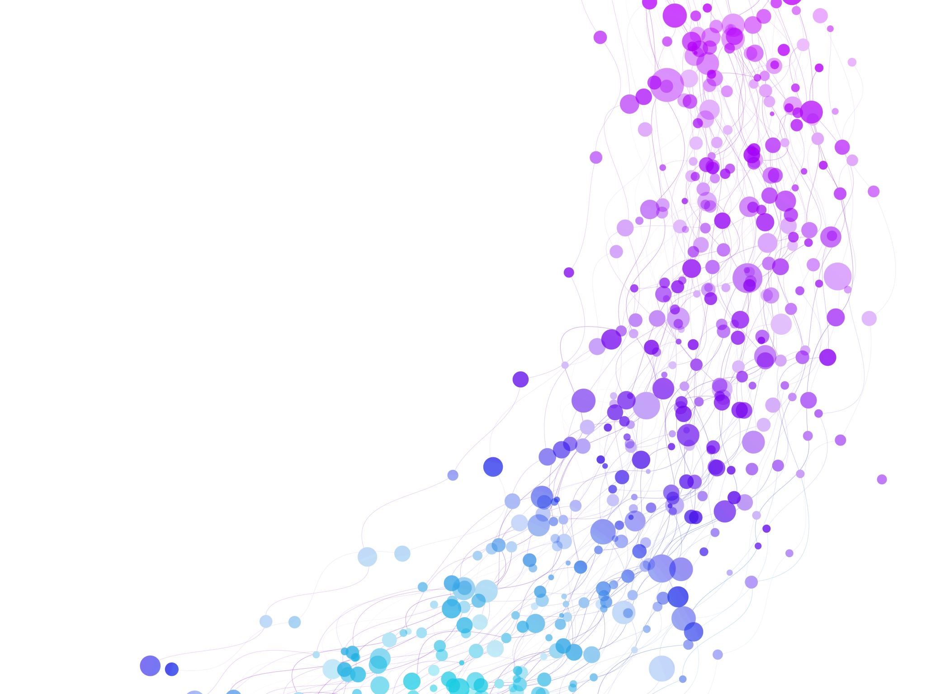


PPOS Tagging - Rule-Based, Statistical, and Deep Learning Session No.: 8 Course Name: Natural language processing Course Code: R1UC616C Instructor Name: Mr. Amit Yadav

Slide 2
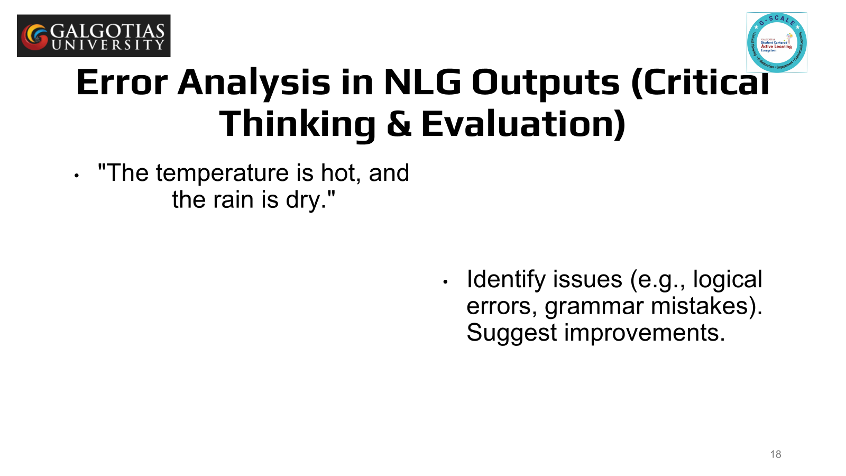
Reflect on the responses of post session activity

Slide 3
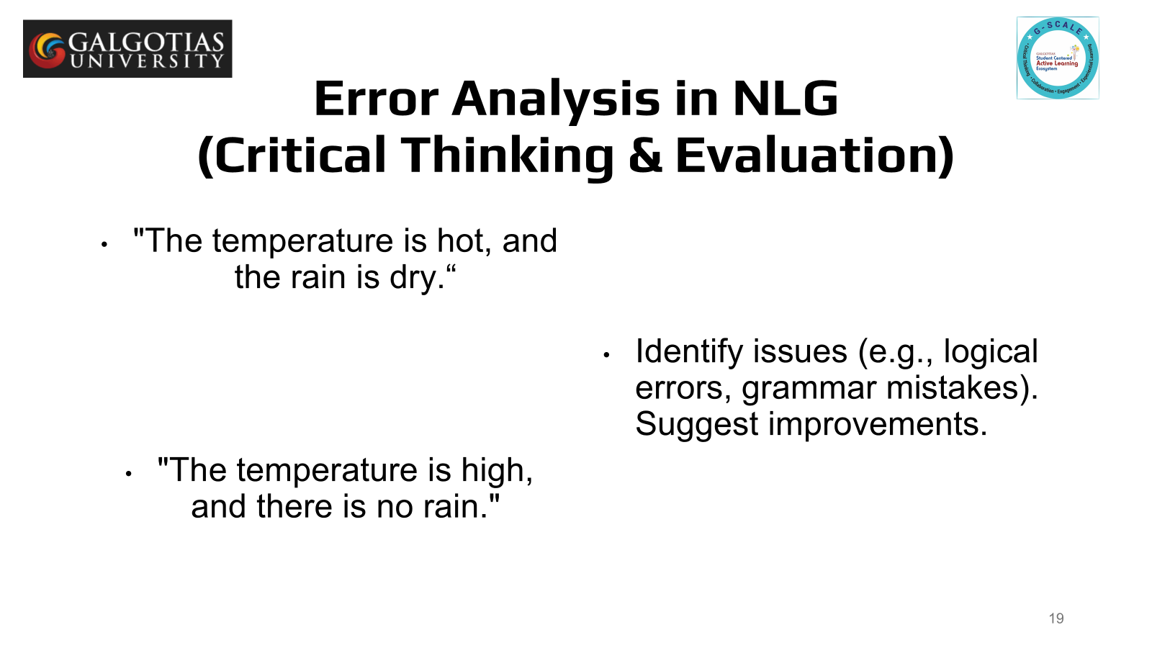
Reflect on the responses of post session activity

Slide 4


Ask Questions
What is mean by sentence
How do you identify important words in a sentence?

Slide 5
At the end of this session students will be able to know
pos
Specific example

Slide 6
Session Outline
1 Definition of parts of speech
2 Understanding the structure of sentence
3 Examples
4 class room activity

Slide 7
Parts of Speech
Parts of speech are categories that words can be grouped into based on their functions within a sentence.
Knowing the rules of parts of speech is essential for understanding grammar and constructing correct sentences.
Nouns
Pronouns
Verbs
Adjectives
Adverbs
Prepositions
Conjunctions
Interjections

Slide 8
Nouns
Nouns represent people, places, things, or ideas.
Rule: Nouns often function as the subject or object in a sentence.
Examples:
Dog (thing)
John (person)
Happiness (idea)

Slide 9
Pronouns
Pronouns take the place of nouns to avoid repetition.
Rule: A pronoun must agree with the noun it replaces in number, gender, and case.
Examples:
She (instead of "Mary")
They (instead of "John and Mark")

Slide 10
Verbs
Verbs show action or state of being.
Rule: A verb must match the subject in tense and number.
Examples:
Run (action verb)
Is (state of being)

Slide 11
Adjectives
Adjectives describe or modify nouns.
Rule: Adjectives typically come before the noun they modify or after certain verbs (like "be").
Examples:
Big (modifying "house")
Happy (modifying "child")

Slide 12
Adverbs
Adverbs modify verbs, adjectives, or other adverbs.
Rule: Adverbs often end in “-ly,” but not always.
Examples:
Quickly (modifying verb "run")
Very (modifying adjective "fast")

Slide 13
Prepositions
Prepositions show relationships between a noun (or pronoun) and other words in the sentence.
Rule: Prepositions often show direction, location, or time.
Examples:
In the box
On the table
At the park

Slide 14
Conjunctions
Conjunctions connect words, phrases, or clauses.
Rule: Conjunctions can be coordinating, subordinating, or correlative.
Examples:
And (coordinating)
Because (subordinating)
Neither...nor (correlative)

Slide 15
Interjections
Interjections are words or phrases used to express strong emotions or sudden reactions.
Rule: They are usually standalone and followed by an exclamation mark.
Examples:
Wow!
Oh no!
Oops!

Slide 16
class room activity
Practice Examples
She runs quickly.
The happy boy is playing in the park.
He studied for the test because it was important.
Wow, that’s amazing!

Slide 17
Rule based POS Tagging
Rule-Based POS Tagging
Definition: Involves using hand-crafted rules to assign tags to words based on predefined linguistic patterns.
Process:
Set of rules defined by linguistic experts (e.g., "If a word ends in '-ing', tag it as a verb").
Uses lexical databases (e.g., WordNet) for reference.
Requires a comprehensive rule set to cover the complexities of language.
Advantages:
Simple to understand and implement.
Provides high accuracy when rules are well-defined for specific contexts.
Disadvantages:
Not scalable to large datasets or diverse contexts.
Difficult to account for ambiguous words or edge cases.

Slide 18
Example of Rule-Based POS Tagging
Example Sentence: "The quick brown fox jumps over the lazy dog."
Rule: If the word is a definite article (e.g., "the"), tag it as a DT (Determiner).
Output:
"The" → DT
"quick" → JJ (Adjective)
"brown" → JJ (Adjective)
"fox" → NN (Noun)
"jumps" → VBZ (Verb)
"over" → IN (Preposition)
"lazy" → JJ (Adjective)
"dog" → NN (Noun)

Slide 19
Statistical POS Tagging
Definition: Involves training a model on large annotated corpora to predict the POS tags based on probability distributions.
Key Models:
Hidden Markov Models (HMM): Uses probabilities of word sequences and their POS tags.
Maximum Entropy Models: Predicts POS tags by calculating the probabilities based on observed features.
Process:
Tagging is based on context and the likelihood of tag sequences.
Statistical models use training data to learn the probability of a word being a specific part of speech, given its surrounding words.

Slide 20
Example of Statistical POS Tagging
Example Sentence: "The quick brown fox jumps over the lazy dog."
HMM-based system:
"The" → DT
"quick" → JJ
"brown" → JJ
"fox" → NN
"jumps" → VBZ
"over" → IN
"lazy" → JJ
"dog" → NN
In this case, the POS tags are predicted based on learned probabilities and contextual patterns from large annotated datasets.

Slide 21
Deep Learning-Based POS Tagging
Definition: Involves using deep learning models (e.g., Recurrent Neural Networks (RNN), Long Short-Term Memory (LSTM), Bidirectional LSTMs, Transformers) to predict POS tags based on large-scale data and context.
Key Approaches:
Recurrent Neural Networks (RNNs): Useful for processing sequential data like text.
LSTM: A type of RNN designed to handle long-term dependencies, making it effective for POS tagging.
Transformer Models (e.g., BERT): These models use attention mechanisms to capture relationships between words in a sequence, providing state-of-the-art results for POS tagging.

Slide 22
Example of Deep Learning-Based POS Tagging
Example Sentence: "The quick brown fox jumps over the lazy dog."
BERT-based POS tagging:
"The" → DT
"quick" → JJ
"brown" → JJ
"fox" → NN
"jumps" → VBZ
"over" → IN
"lazy" → JJ
"dog" → NN
BERT or similar models would take into account the entire context of the sentence to predict tags.

Slide 23
comparison
Technique | Accuracy | Scalability | Context Sensitivity | Complexity
Rule-Based | High (in specific contexts) | Low | Low | Simple
Statistical | Moderate-High | Moderate | Moderate | Moderate
Deep Learning | Very High | High | Very High | High

Slide 24
Applications
Information Extraction
Sentiment Analysis
Speech Recognition
Machine Translation

Slide 25
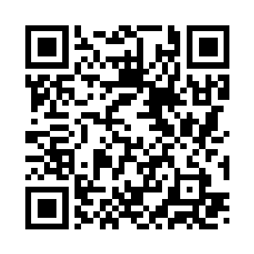
Review and Reflection from students
Participation link
BXEROE
https://app.wooclap.com/BXEROE?from=instruction-slide

